Slide 1
MODS App
Group 3

Slide 2

Goal
Our goal is to create an app that creates an educational, helpful and easy experience for the visitors at the museum. The target group for the visitors is a wide range; from children to students, to adults. Giving users a more immersive museum experience.

Slide 3
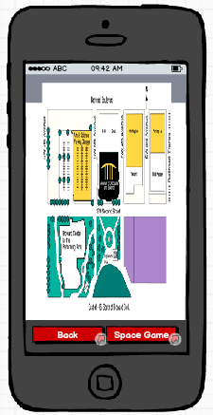
Floor Map
The app will mainly focus on a digital and interactive floor plan. At the welcome screen, the user may tap “Floor Plan” to display a map of the first floor. To view the second floor, the user will simply swipe up. The user will be able to zoom/auto-zoom, click on each individual exhibit, and see the icons of exhibits on display.

Slide 4
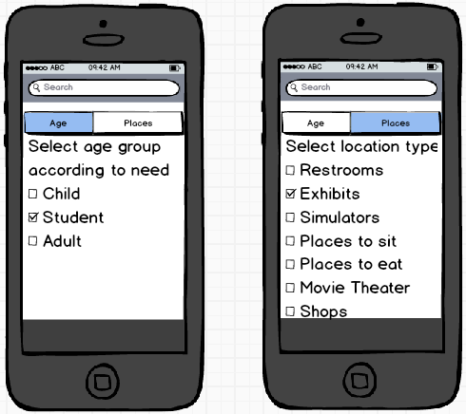
Floor Map Menu
When the user swipes to the left revealing tabs and options that will allow the user to personalize the app. They will have options to change the audience of the app and the exhibits and activities they are looking for. The app will show icons, which represent the exhibits.The swiped in menu will also have a search bar that can search for a particular exhibit.

Slide 5
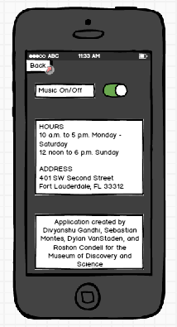
About/Options Page
The About/Options page will allow the user to turn on/off the music. It will also inform the user on museum hours, the phone number, and the address of the museum. It will also tell the users who the created the application.

